Slide 1
A Data-Driven Guide to Vinho Verde: Insights on Composition and Quality
Gökçe Şanlıalp
Code Academy Berlin
27.02.2025

Slide 2
Agenda
Part 1: What is Vinho Verde
Part 2: The dataset
Part 3: Exploratory Data Analysis (EDA) and Visualisation and ANOVA test results
Part 4: Discussion

Slide 3
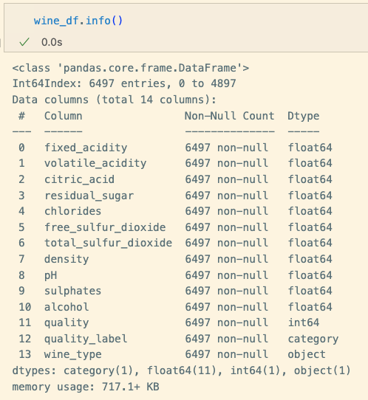
Dataset Overview
Source: UCI Machine Learning Repository https://archive.ics.uci.edu/dataset/186/wine+quality
Name: Wine Quality
Type: Structured dataset containing physicochemical and sensory properties of wines
Total Records: 6.497 wine samples
Red Wine: 1.599 samples
White Wine: 4.898 samples
Features: 11 chemical properties + 1 quality score
Target Variable: Quality (Rated from 0 to 10 by wine experts)
Notes:
There are approximately three times more white wine samples than red in our dataset. This reflects real-world trends—white Vinho Verde is far more commonly produced and exported than red. While red Vinho Verde is a traditional specialty, it remains less widely available compared to its white counterpart.

Slide 4
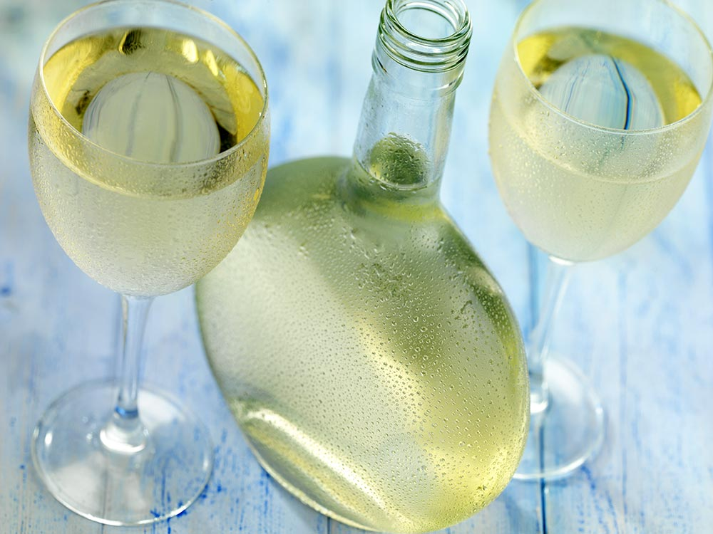
Vinho Verde: General Characteristics
📍 Northern Portugal
“Verde” (Green) = Young, not colour
White Vinho Verde is the most famous
Fresh, light, and slightly effervescent
Naturally fizzy (residual CO₂), high acidity
low alcohol (9-12%)
Frischer, junger Vinho Verde © Adobe Stock, cdkproductions
Notes:
Vinho Verde is a unique wine region in northern Portugal. Despite the name 'Verde' (meaning Green), it refers to the young age of the wine, not its color. The region produces white, red, and rosé wines, but white Vinho Verde is the most well-known. These wines are fresh, crisp, and often naturally slightly fizzy due to residual CO₂ from fermentation. They typically have high acidity and a low alcohol content of 9 to 12%, making them perfect for a refreshing summer drink.

Slide 5
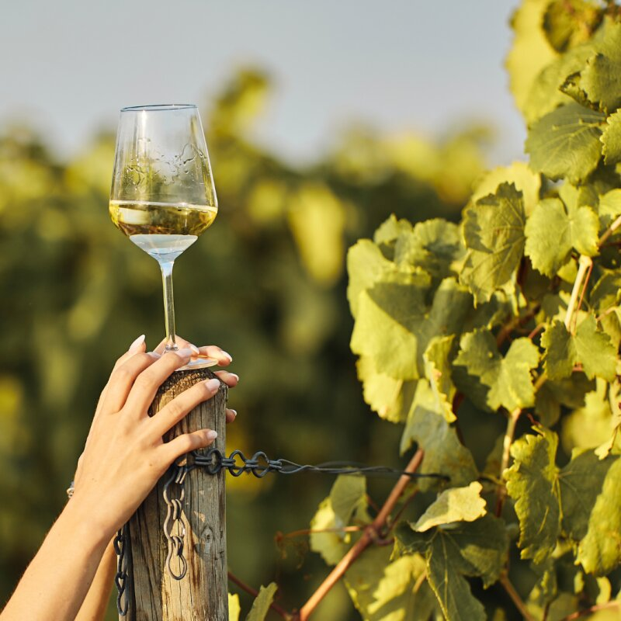
White Vinho Verde (Vinho Verde Branco)
Light-bodied, high acidity, and refreshing.
Aromas of citrus, green apple, and tropical fruits with a slight mineral touch.
Density: 0,990 – 0,998 g/cm³ → light and crisp.
Residual Sugar: 0-4 g/L → Usually dry, but some off-dry styles exist.
https://www.special-wines.de/Frischer-Genuss-aus-Portugal-Vinho-Verde-Leicht-fruchtig-und-erfrischend-Santa-Christina

Slide 6
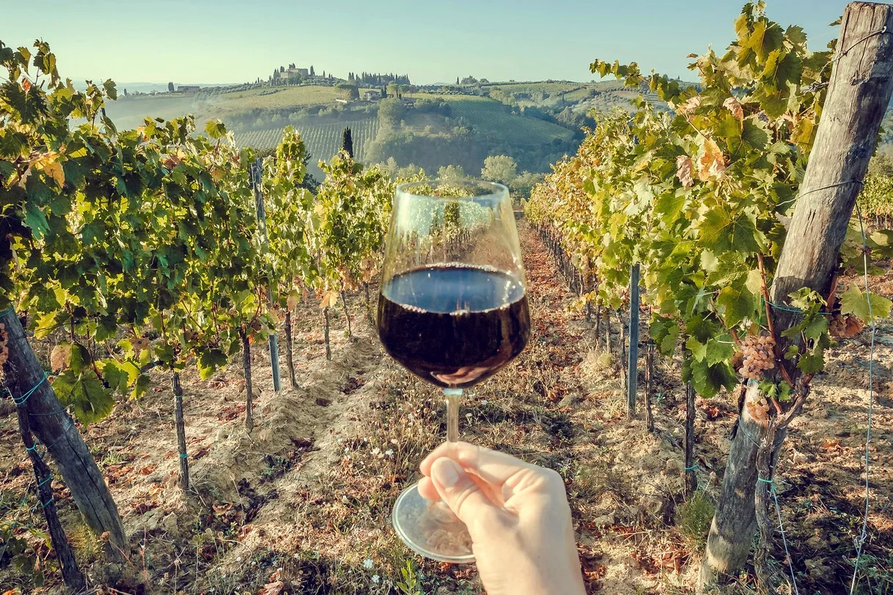
Red Vinho Verde (Vinho Verde Tinto)
Much less known but traditional in Portugal
Deep purple color, high acidity
Often served chilled
Density: 0,990 – 0,997 g/cm³ → Slightly heavier than white
Residual Sugar: 3-8 g/L → Slightly off-dry to balance acidity.
https://www.ohmycodtours.com/fr/blog/portuguese-vinho-verde-green-wine-is-much-more-than-a-sparkling-wine/

Slide 7
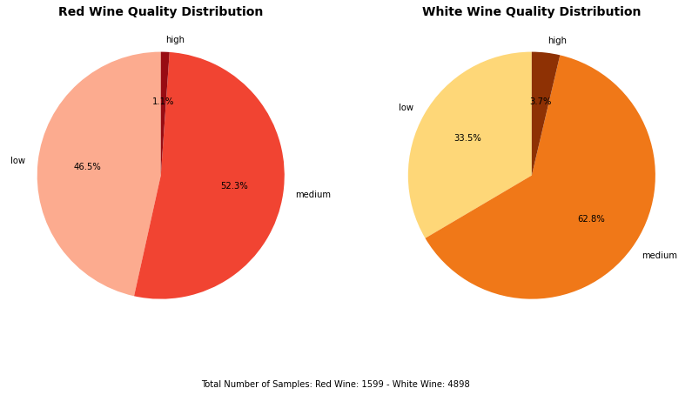
Key Takeaways:
✔ White Vinho Verde is lighter, drier, and crisper with lower density and minimal sugar. ✔ Red Vinho Verde is more structured, slightly heavier, and sometimes off-dry. ✔ Both wines share a high-acid, fresh style, making them great for summer drinking.
Notes:
Before diving into the composition, let’s take a look at the quality distribution of red and white Vinho Verde and compare the two in general.
You enjoy this fresh wine next to the ocean on a warm day, not at your Berlin flat with your seasonal depression.

Slide 8
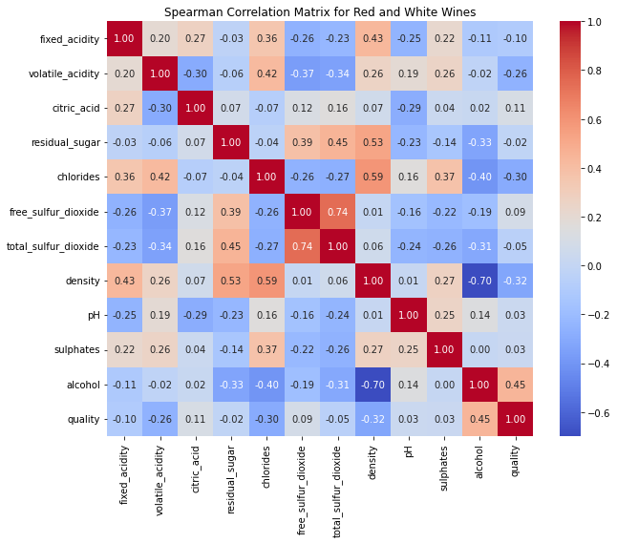
Notes:
By default, correlation calculations use Pearson, which assumes a linear relationship. However, since wine quality does not always change in a strictly linear way with chemical properties, I used Spearman correlation instead. Spearman is better suited for capturing monotonic trends, where values increase or decrease consistently but not necessarily at a fixed rate. This makes it more reliable for analyzing complex relationships in wine quality.

Slide 9
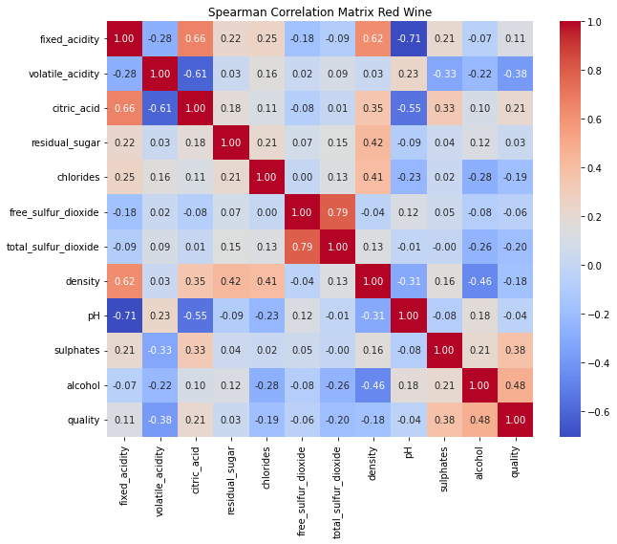
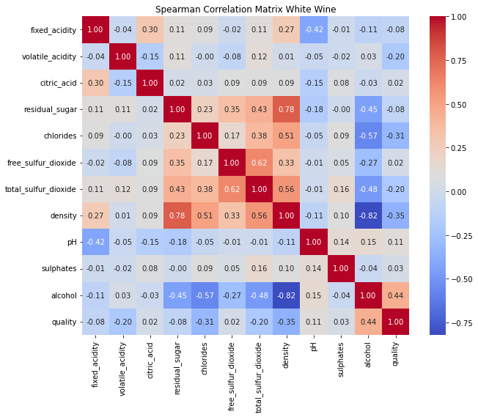
Notes:
I’ve focused on alcohol content, density, volatile acidity and sulphates.
Citric Acid and Residual Sugar contents are Weaker but still statistically significant.

Slide 10
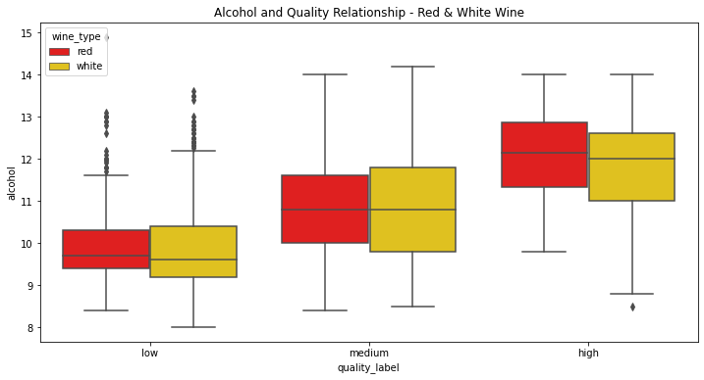
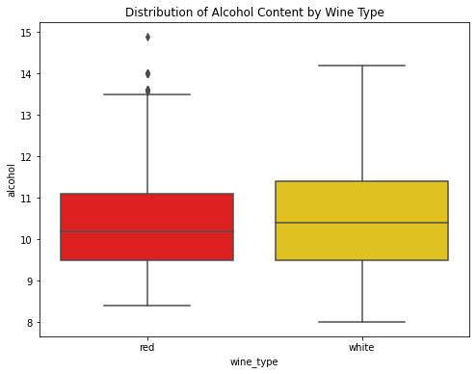
F-statistic = 673,07
p < 0,05
Statistically meaningful difference in alcohol content across different wine qualities
Notes:
As we can see in the left plot, wine quality tends to increase with alcohol content. Higher-quality wines—both red and white—generally contain more alcohol, while lower-quality wines have lower alcohol content. This suggests that alcohol plays a significant role in shaping perceived wine quality.
The plot on the right compares alcohol content between red and white wines. While their median alcohol levels are similar, white wines show a slightly wider range. Some white wines reach up to 14% alcohol, whereas red wines are more concentrated around 10-11%. Despite these variations, alcohol remains a strong predictor of wine quality across both types
This is in line with ANOVA test result findings.
According to that the F-statistic is 673.07, indicating a significant variation between different wine quality groups. The p-value is well below 0.05, which tells us that there is a statistically meaningful difference in alcohol content across different wine qualities.
Alcohol is more than just a percentage on the label—it significantly impacts how wine is perceived and rated. This makes it a key factor in understanding and predicting wine quality.

Slide 11
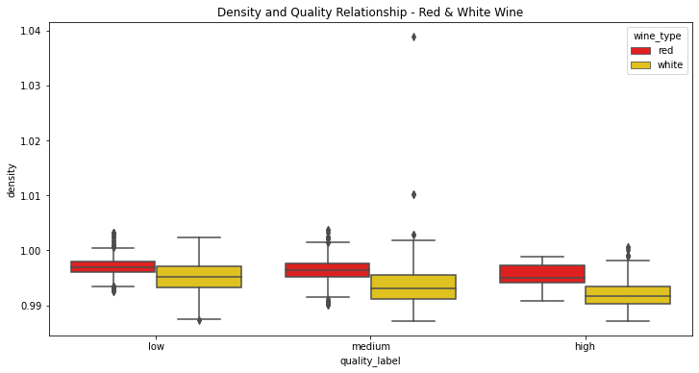
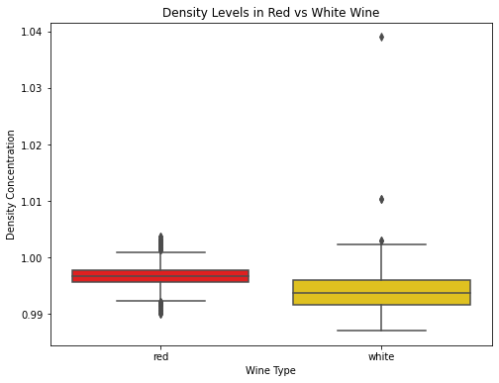
F-statistic = 287,59
p < 0,05
Statistically meaningful difference in density across different wine qualities
Notes:
As shown in the left plot, density tends to decrease slightly as wine quality improves. This makes sense because higher-quality wines often have more alcohol. Additionally, white wines tend to have slightly lower density than red wines, reflecting their generally drier and lighter composition.
The plot on the right compares density between red and white wines. While the density ranges are similar, white wines tend to have slightly lower density than red wines, making it light-bodied and refreshing and enhancing the crisp, fresh mouthfeel.
For red wine, it’s higher due to tannins and pigments. Higher density gives it a more textured, fuller feel while maintaining Vinho Verde’s signature freshness.
The ANOVA test for density and wine quality resulted in a highly significant difference (F = 287.59, p < 0.05), confirming that density plays a crucial role in differentiating wine quality. Since density is closely linked to residual sugar and alcohol content, it directly impacts a wine’s body and perception.

Slide 12
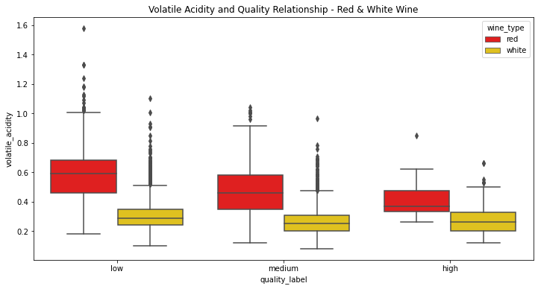
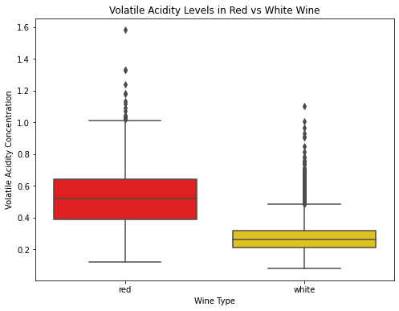
F-statistic = 3,43
p < 0,05
Statistically meaningful difference in volatile acidity across different wine qualities
Notes:
The plot on the left shows that volatile acidity tends to be higher in lower-quality wines. This makes sense because excessive volatile acidity can create sharp, vinegar-like aromas that negatively impact wine perception. We also see that red wines have significantly higher volatile acidity than white wines, which aligns with differences in fermentation and aging processes.
The plot on the right hand side confirms that red wines naturally have higher volatile acidity than white wines. This is due to differences in grape varieties and fermentation techniques. White wines, on the other hand, are more controlled in acidity, leading to a smoother and fresher profile.
The ANOVA test for volatile acidity and wine quality resulted in a statistically significant difference (F = 3.43, p < 0.05), confirming that volatile acidity influences wine quality.
However, red and white wines combined, the effect is not as strong as other factors like alcohol or density.

Slide 13
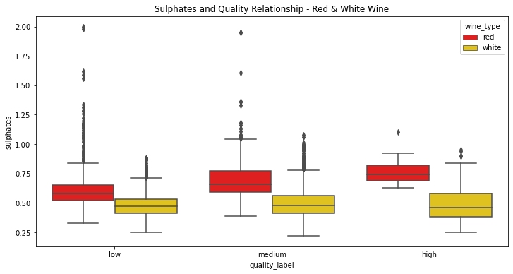
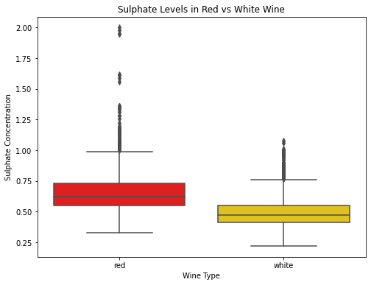
Notes:
The plot on the left hand side shows that higher-quality wines tend to have slightly higher sulphate levels. This makes sense because sulphates are used as preservatives and antioxidants, helping to stabilize wine and prevent oxidation. We also see that red wines generally contain more sulphates than white wines, likely due to their longer aging process and different winemaking techniques.
The plot on the right confirms that sulphates are generally higher in red wines compared to white wines. This aligns with the fact that red wines undergo longer aging and require more stabilization. White wines, which are usually consumed younger, have more controlled and consistent sulphate levels.

Slide 14
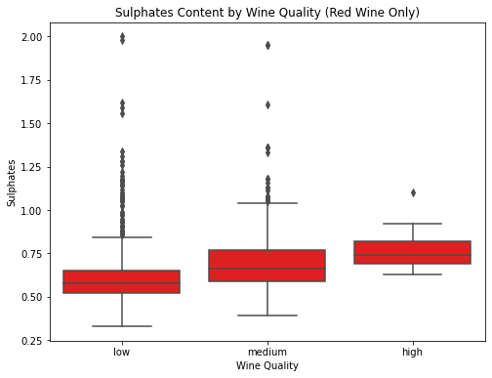
F-statistic = 41,84
p < 0,05
Statistically meaningful difference in sulphates acidity across different red wine qualities
Notes:
To further examine sulphates in red wines, here the focus is only on red wine quality levels. We see a slight increase in sulphates as quality improves, confirming that controlled sulphate use plays a role in higher-quality red wines. However, too much sulphate can lead to instability, as seen in the outliers.
The ANOVA test for red wines confirms that sulphate levels significantly differ across quality categories (F = 41.84, p < 0.05). This suggests that controlled sulphate use may contribute to wine stability and perceived quality.

Slide 15
Discussion
What do the ANOVA results tell us? → "The biggest difference across quality levels is in alcohol content and density, while volatile acidity has a smaller impact.”
What are the implications for wine producers? → "Producers aiming for higher quality should consider optimizing alcohol content and density balance.”
Future Analysis: → "Further studies could explore the impact of citric acid and residual sugar on wine quality.”
Ultimately, the balance of alcohol, density, and acidity is key to wine quality—small adjustments in composition can significantly impact perception and market value.
Our findings suggest that wine quality is not about maximizing one component but finding the 'sweet spot'—a balanced interplay of its components.
Cheers!

